Slide 1
Estimating trends in cardiovascular risk: Creating a harmonised dataset using Health Survey for England 1998-2017
Shaun Scholes
Principal Research Fellow, Epidemiology and Public Health
HSE Annual Seminar
January 7, 2025
s.scholes@ucl.ac.uk

Slide 2
Background
ExPoSE: Explaining Population Trends in Cardiovascular Risk in South Africa and England 1998-2017
Employs data from nationally-representative repeated cross-sectional surveys conducted in England (HSE) and in South Africa with the goal to:
Describe recent trends in CVD risk
Identify demographic, behavioural, social and environmental factors that may explain the observed trends in CVD risk and to what extent
Determine the amount of population change in CVD risk that is unaccounted for by these factors

Slide 3
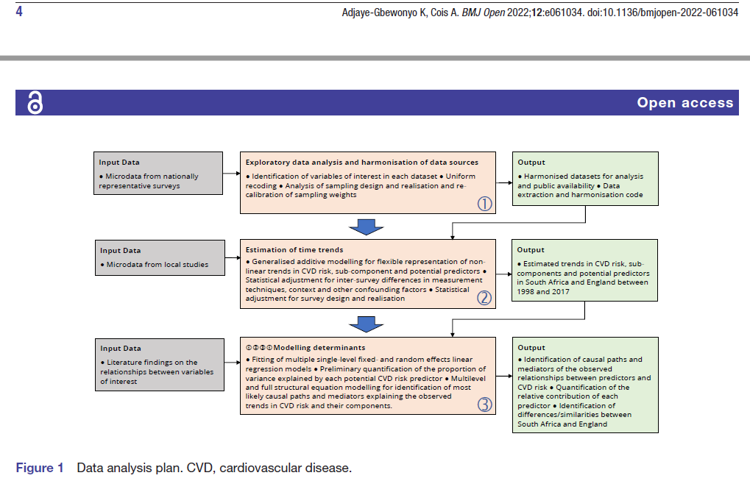
Data analysis plan
Notes:
Put briefly, Harmonising / put together 17 separate HSE datasets into a single dataset to enable: (i) estimation of trends in CVD risk and (ii) in its sub-components. CVD risk is a case-study. The harmonised dataset could be used for other purposes.

Slide 4
A harmonised dataset using HSE 1998-2017
HSE is an annual cross-sectional survey, but with an important focus on monitoring trends….
But very often this does not require a harmonised dataset
Harmonised datasets of HSE data (combining data across years) have been created for various projects, including the recent report on ethnicity and health (2022), and for peer-reviewed publications
Resources for harmonising ageing cohorts such as ELSA are available (https://g2aging.org/home) but not for health surveys such as the HSE
An important goal of this project was to use our knowledge/experience to produce outputs (e.g. harmonisation code) for the wider research community

Slide 5
Creating a harmonised dataset using HSE
Challenges in compiling this dataset to examine CVD risk over time included:
Boost samples of population subgroups (minority ethnic groups; older persons)
Gaps in survey years (core / additional content)
Random allocation of questionnaire modules
Changes in question wording (shift in policy focus; harmonisation with other surveys)
Changes in variable derivation / names
Changes in measuring equipment (e.g. BP monitors)
Changes in methods (such as non-response weighting)
Stricter guidelines regarding data release (e.g. banded rather than continuous age)

Slide 6
Harmonised variables, including:
Section | Components
Demographics | Sex; age; marital status; ethnicity; region
Socioeconomic | Income; social class; Index of Multiple Deprivation
Geography | Region; urban/rural
Anthropometry | Height*; weight*; BMI*
Biomarkers | BP (hypertension*); cholesterol (raised cholesterol*); glycated haemoglobin
Health indicators | Diagnosed conditions (e.g. diabetes*; CVD*) Use of medicines Self-rated health* / Long-standing/lasting illness*
Lifestyle behaviours | Smoking*; physical activity; alcohol*; fruit and vegetables consumption*
Sampling design | PSU; weights (interview; nurse; blood-sample); year
* Trend tables published in HSE reports; CVD risk score components

Slide 7
Descriptive analysis using the harmonised dataset
(1) For each available survey year, estimate:
Predicted mean 10-year risk of CVD (%):
WHO and Globorisk equations (laboratory and non-laboratory based) relevant to England and South Africa
Individual components of CVD risk scores:
Current smoking (%); SBP; diagnosed diabetes (%); total cholesterol; body mass index
(2) Use linear regression to estimate annual change in mean 10-year CVD risk
Notes:
Others include Framingham and QRISK.

Slide 8
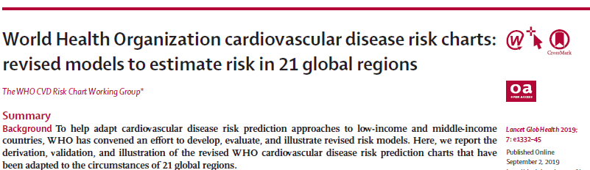
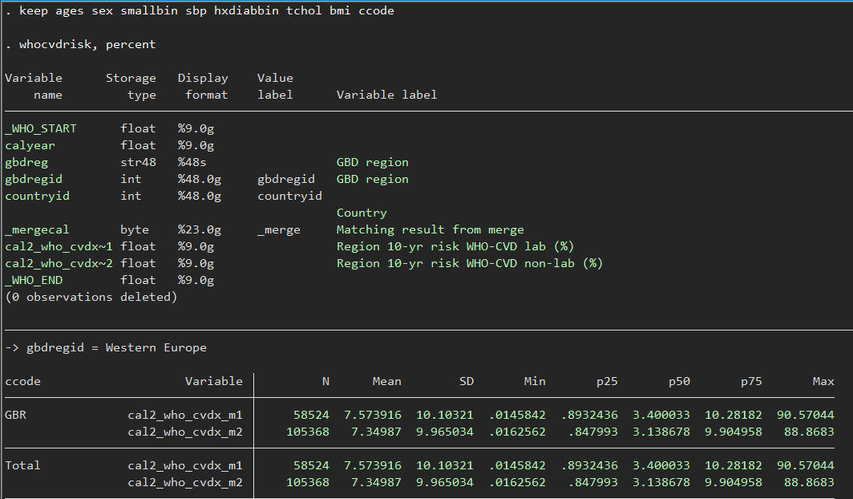
Calculating 10-year CVD risk: WHO

Slide 9
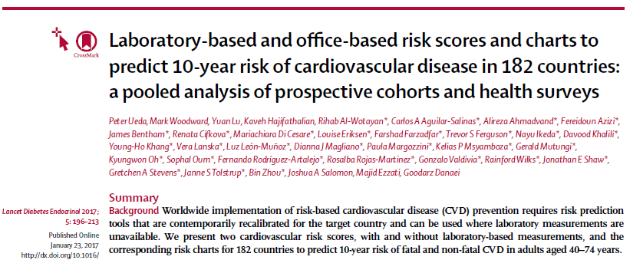
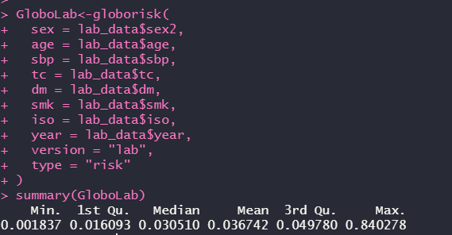
Calculating 10-year CVD risk: Globorisk
https://github.com/boyercb/globorisk

Slide 10
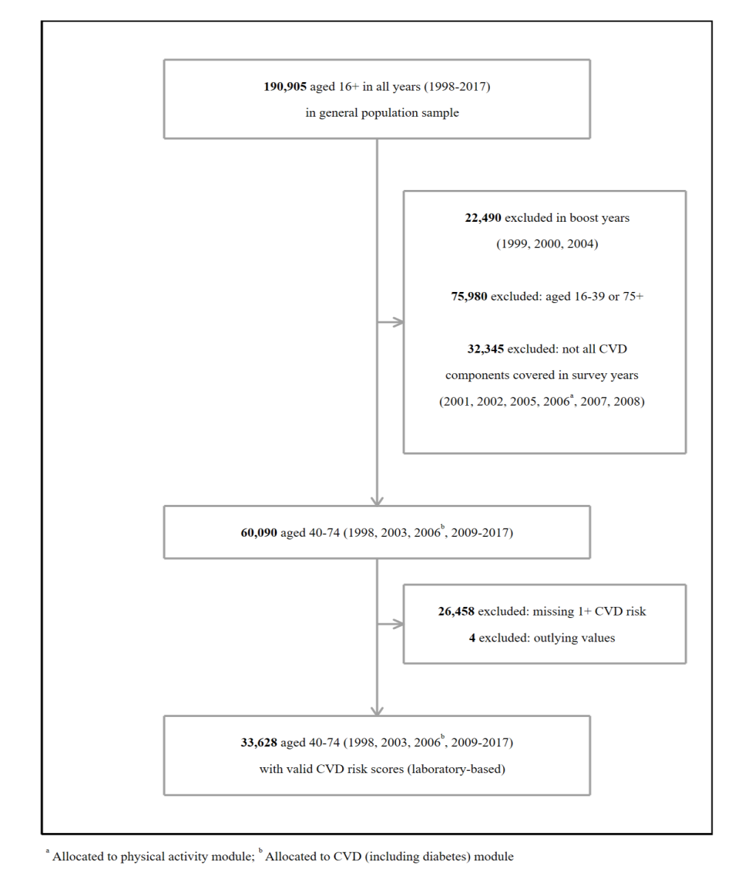
CVD risk scores (lab-based)

Slide 11
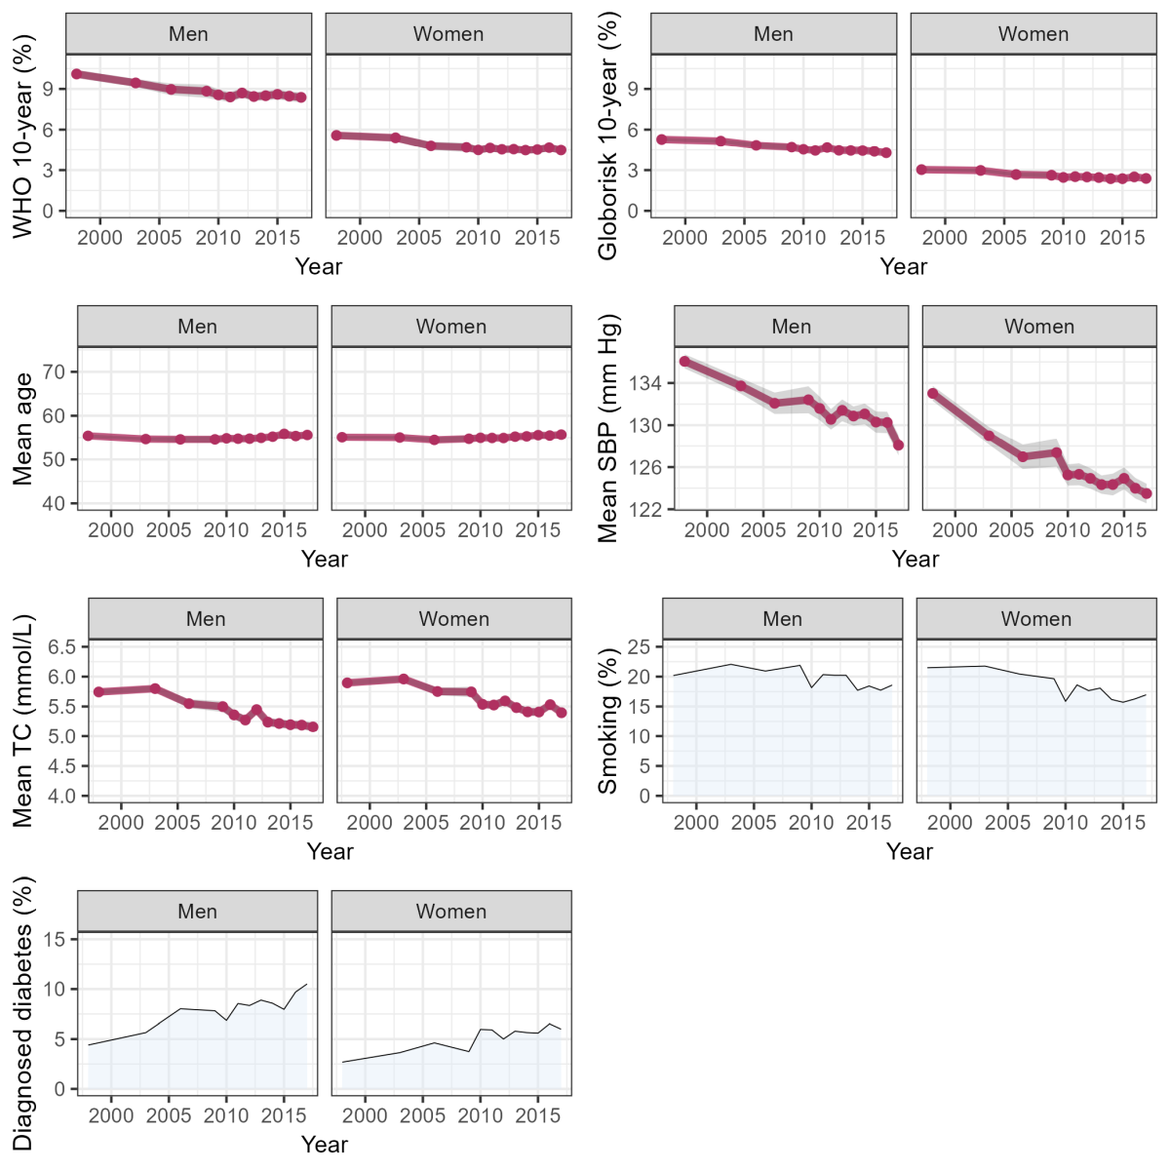
CVD risk and its components by year

Slide 12
Change (%) in mean 10-year CVD risk (lab-based scores)
 | WHO |  | Globorisk
 | β (95% CI) | P-value | β (95% CI) | P-value
Annual change:
Men | -0.09 (-0.11 to -0.07) | <.001 | -0.05 (-0.06 to -0.05) | <.001
Women | -0.06 (-0.08 to -0.05) | <.001 | -0.04 (-0.04 to -0.03) | <.001
1998 to 2017:
Men | -1.76 (-2.09 to -1.42) | <.001 | -1.02 (-1.17 to -0.86) | <.001
Women | -1.21 (-1.47 to -0.95) | <.001 | -0.73 (-0.85 to -0.62) | <.001

Slide 13
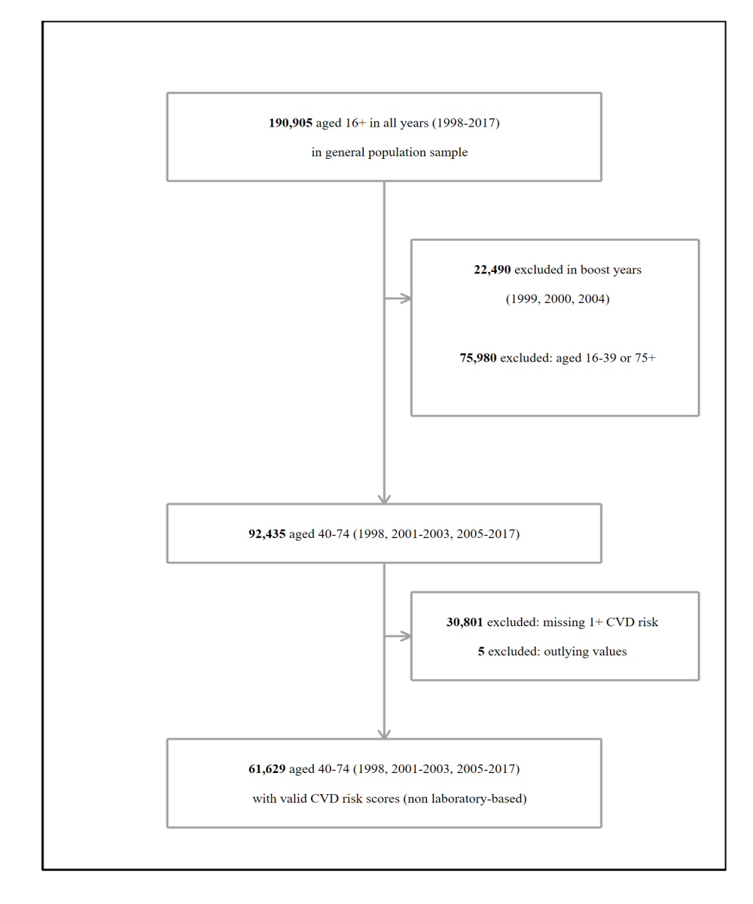
CVD risk scores (non-lab based)

Slide 14
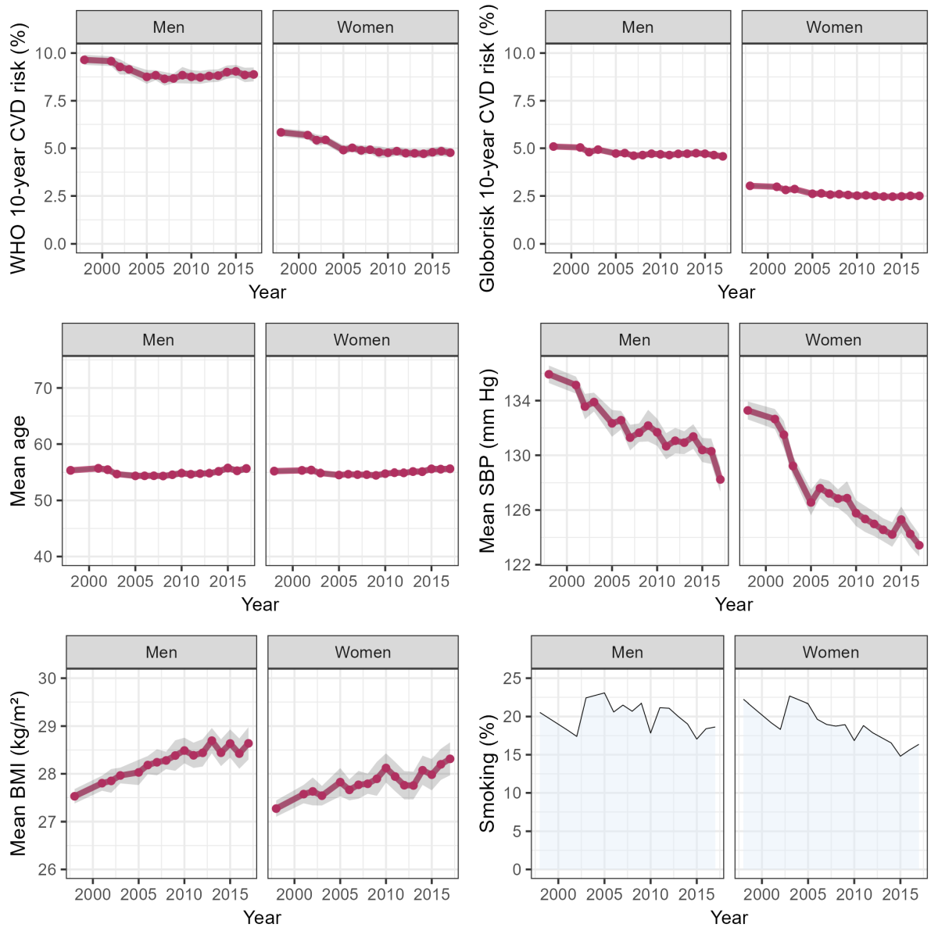
CVD risk and its components by survey year

Slide 15
Change (%) in mean 10-year CVD risk (non- lab-based scores)
 | WHO |  | Globorisk
 | β (95% CI) | P-value | β (95% CI) | P-value
Annual change:
Men | -0.04 (-0.06 to -0.03) | <.001 | -0.02 (-0.03 to -0.02) | <.001
Women | -0.06 (-0.07 to -0.05) | <.001 | -0.03 (-0.04 to -0.03) | <.001
1998 to 2017:
Men | -0.78 (-1.05 to -0.52) | <.001 | -0.45 (-0.56 to -0.34) | <.001
Women | -1.20 (-1.41 to -1.00) | <.001 | -0.63 (-0.71 to -0.54) | <.001

Slide 16
Summary of findings
Significant declines in 10-year CVD risk across all algorithms
Divergent trends in individual CVD risk components:
Declines in smoking (women), SBP, total cholesterol
Increases in BMI and diagnosed diabetes
Explanations for declines in 10-year CVD risk include:
Policy and regulatory measures (e.g. tobacco taxation and antismoking legislation)
Public health campaigns
Improvements in early detection and management of CVD-related conditions (e.g. hypertension and high cholesterol)

Slide 17
Dissemination/Resources
Study protocol:
Adjaye-Gbewonyo K, Cois A. Explaining population trends in cardiovascular risk: protocol for a comparative analysis of health transitions in South Africa and England using nationally representative survey data. BMJ Open 2022;12:e061034.
Study website: https://www.exposeproject.net/
Codebook and harmonised code repository: https://www.datafirst.uct.ac.za/dataportal/index.php/catalog/981/related-materials
https://github.com/AnnibaleCois/expose_code
HSE workflow:
SPSS: initial harmonisation and appends datasets (SS)
Stata: additional data cleaning and harmonisation (KAG)
R: calculation of 10-year CVD risk (AC)
Notes:
We cannot provide the dataset. Users must register with the UKDS.

Slide 18
Manuscript
Scholes S, Mindell JS, Toomse-Smith M, Cois A, Adjaye-Gbewonyo K.
Estimating Trends in Cardiovascular Disease Risk for the ExPoSE (Explaining Population Trends in Cardiovascular Risk: A Comparative Analysis of Health Transitions in South Africa and England) Study: Repeated Cross-Sectional Study
JMIR Cardio 2025 (in-press)
Stata do-file (SS):
https://github.com/shauns11/Creating-a-harmonised-dataset-Health-Survey-for-England-

Slide 19


Acknowledgements
ExPoSE team: Jenny Mindell, Mari Toomse-Smith, Annibale Cois, Kafui Adjaye-Gbewonyo
Staff of the Joint Health Surveys Unit of UCL and NatCen
Health and Social Surveys Research Group, Research Dept of Epidemiology & Public Health, UCL
NatCen Social Research
Interviewers and nurses
Participants in the health surveys
NHS England – who fund the HSE
ESRC – who funded the ExPoSE project

